Slide 1



Project Schedule Management
LECTURE # 7

Slide 2
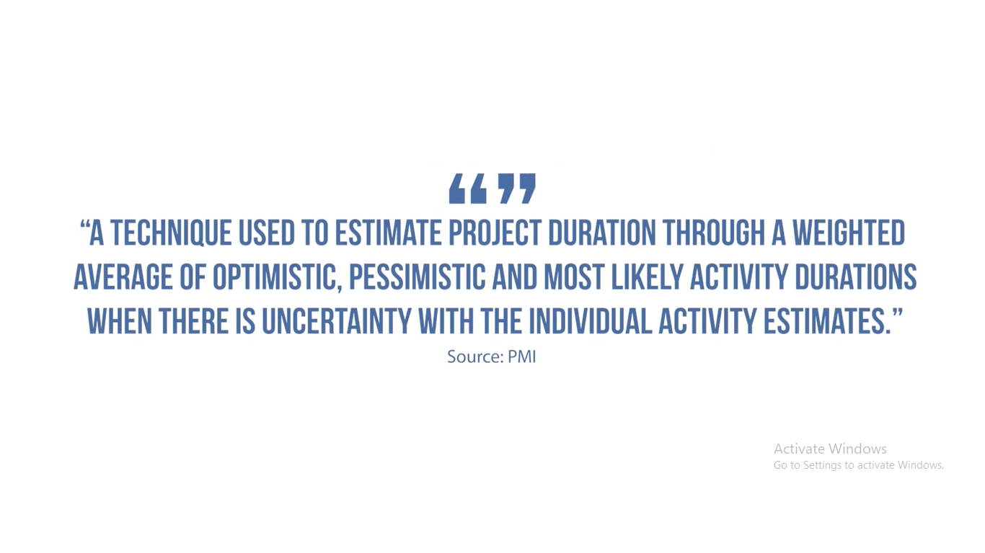

Slide 3
PERT stands for Program Evaluation Review Technique and it is the most common form of three-point estimation.
It was developed jointly by the U.S. Navy, Lockheed Martin and the consulting firm of Booz, Allen and Hamilton working on the Polaris nuclear submarine project during the 1950s.
PERT is one of the most commonly used techniques used along with Critical Path Method (CPM) to estimate the minimum time needed to complete a project.

Slide 4


Slide 5


Slide 6


Slide 7

EXAMPLE

Slide 8


Slide 9


Slide 10


Slide 11


Slide 12


Slide 13
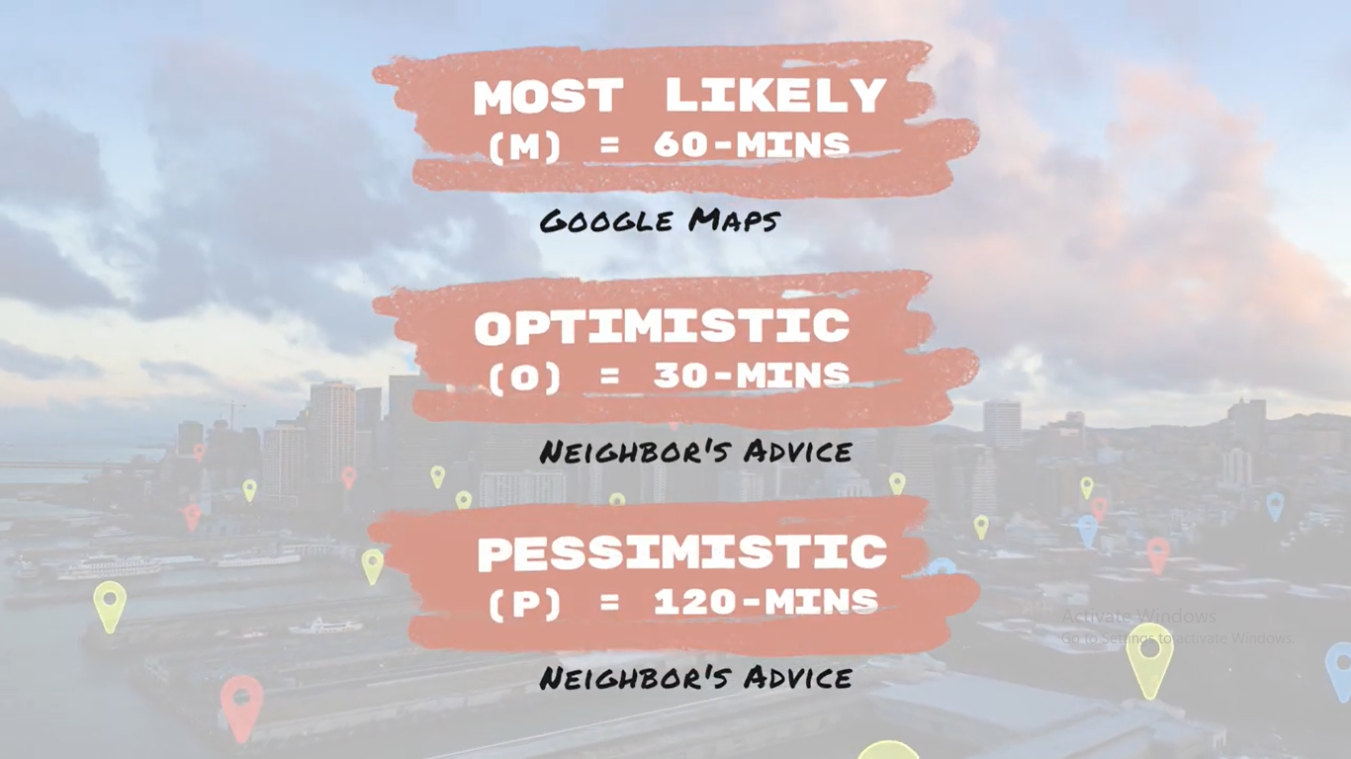

Slide 14
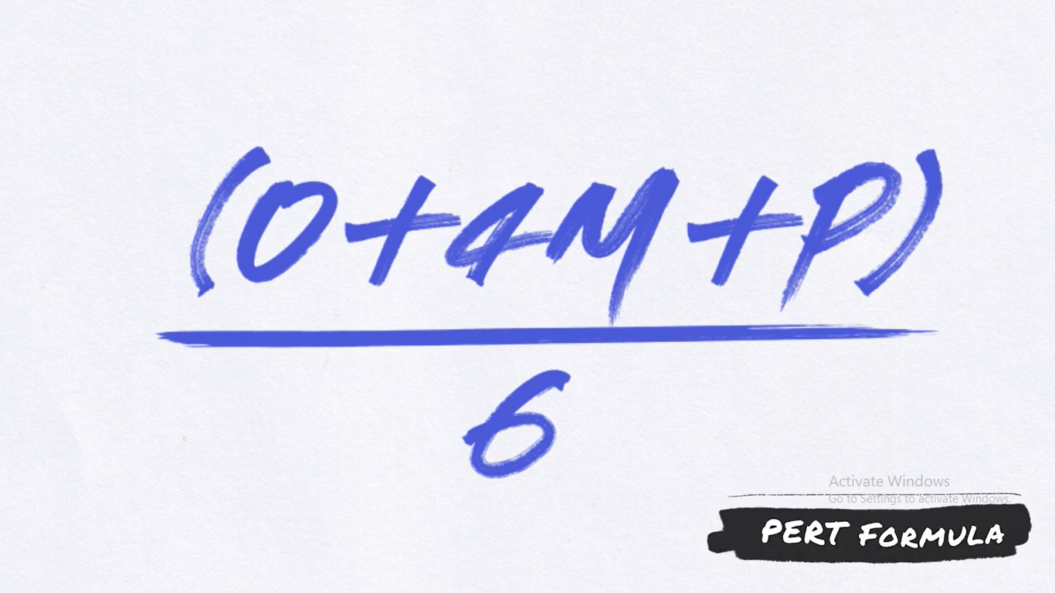

Slide 15


Slide 16

Appendix 7.1
PERT and PERT Simulation

Slide 17
PERT—Program Evaluation Review Technique
Assumes each activity duration has a range that statistically follows a beta distribution.
Uses three time estimates for each activity: optimistic, pessimistic, and a most likely to represent activity durations.
  Knowing the weighted average and variances for each activity allows the project planner to compute the probability of meeting different project durations.

Slide 18
Advantages of PERT
1.Increased accuracy over one-point estimates
  Usually, when asked to provide estimates, the team members think about a single number and pad it as much as they possibly can. They realize that the project manager may cut down on it. That is definitely not the way to get good estimates.
2. Better commitment from the project team members
  Since the estimate is provided by the team members, they are much more accountable.
3. Realistic estimates
  By estimating in a range, you are able to generate a more realistic estimate. This is a clear indication to the stakeholders and project sponsor that the estimates are not 100% accurate. There are risks that have been considered that may impact the amount of time and cost the task will take. This approach addresses some of the team members’ uncertainty that is associated with the estimation process

Slide 19
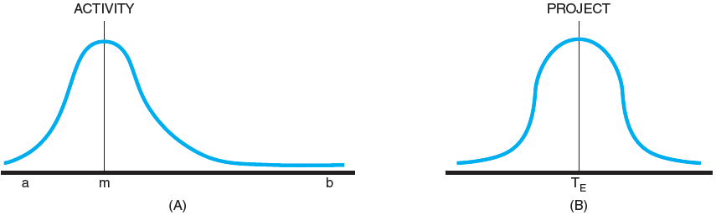
Activity and Project Frequency Distributions
FIGURE A7.1

Slide 20
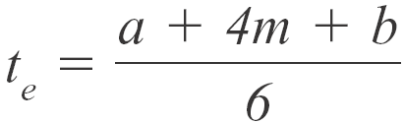
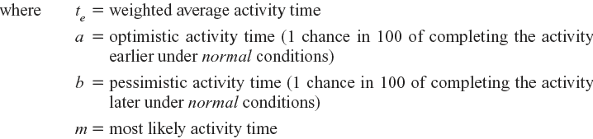
Activity Time Calculations
The weighted average activity time is computed by the following formula:
(7.1)

Slide 21
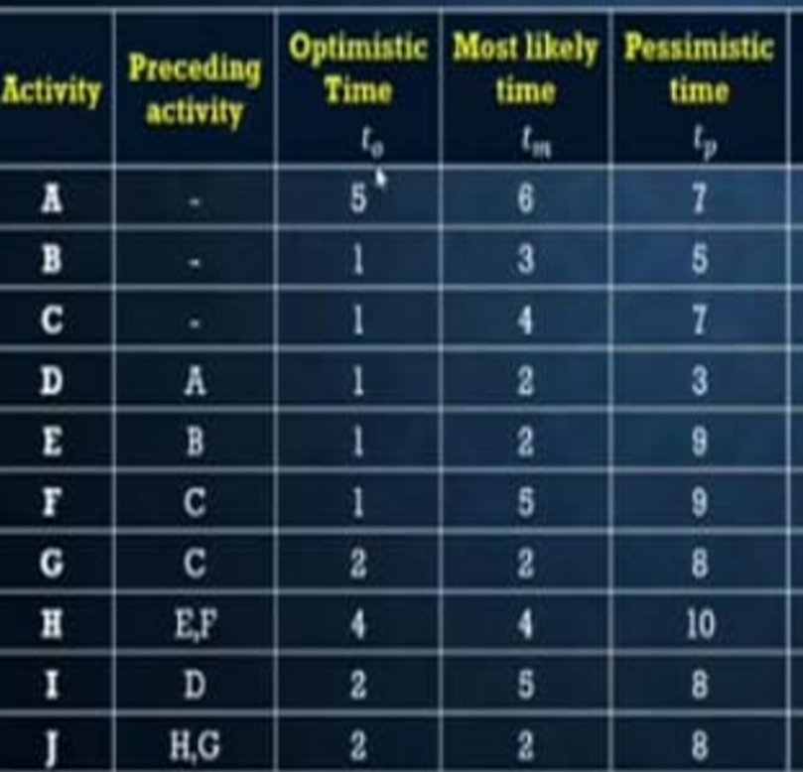
PERT
Construct network diagram and determine the critical path
Determine expect project length
Determine Mean/Expected time & Variance of the project
What is the probability of completing the project on or before 22 weeks

Slide 22
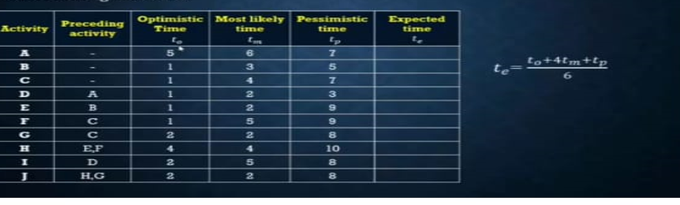

Slide 23
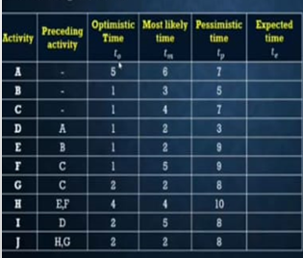
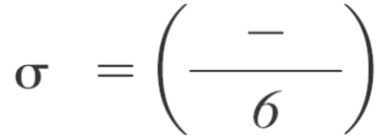
Variance
0.11
0.44
1
0.11
1.77
1.77
1
1
1
1
t_{p}
t_{o}
2
2
6
3
4
2
3
5
3
5
5
3

Slide 24
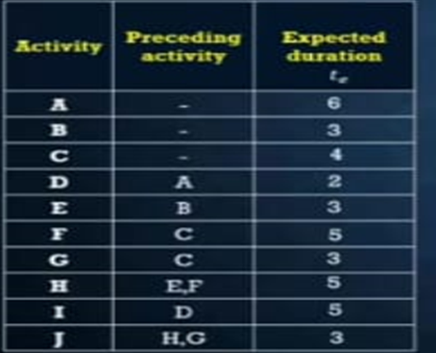
START
FINISH

Slide 25
6
D
8
I
8
13
4
4
4
4
10
2
12
12
5
17
0
A
6
4
3
E
6
4
3
4
6
10
3
9
H
14
J
17
6
3
9
14
0
B
3
0
0
0
0
START
3
4
F
9
9
14
3
17
3
5
14
0
3
3
6
0
4
5
9
FINISH
0
C
4
4
G
7
0
0
10
10
0
4
4
14
3
17

Slide 26
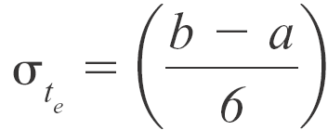

Activity Time Calculations (cont’d)
The variability in the activity time estimates is approximated by the following equations:
The standard deviation for the activity:
(7.2)
The standard deviation for the project:
(7.3)
Note the standard deviation of the activity is squared in this equation; this is also called variance. This sum includes only activities on the critical path(s) or path being reviewed.

Slide 27


Probability of Completing the Project
The equation below is used to compute the “Z” value found in statistical tables (Z = number of standard deviations from the mean), which, in turn, tells the probability of completing the project in the time specified.
(7.4)

Slide 28

Z CALCULATION
Z= P (x< 22)= x- -
Step 1:
Critical Path: C-F-H-J
Step 2:
SD= 1+1.77+1+1
4.77 =2.18
Step 3: Computing Values
22-17
= _____=2.29
2.18
Step 4: Look at Z Table to find value
0.9890 or 98.90 %

Slide 29
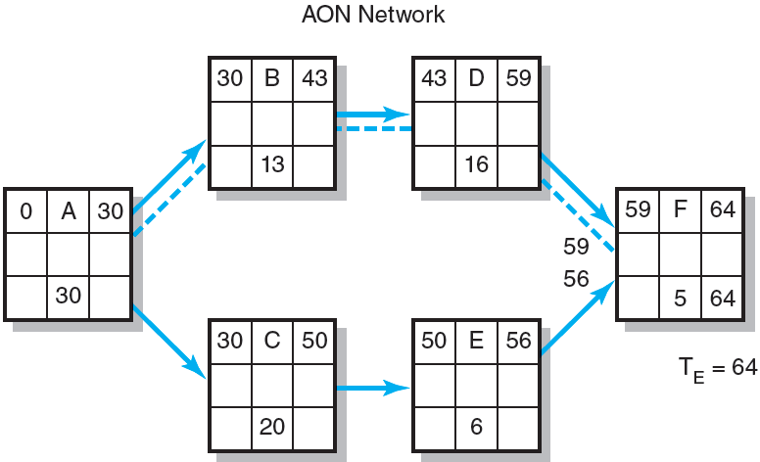
Hypothetical Network (cont’d)
FIGURE A7.2 (cont’d)

Slide 30
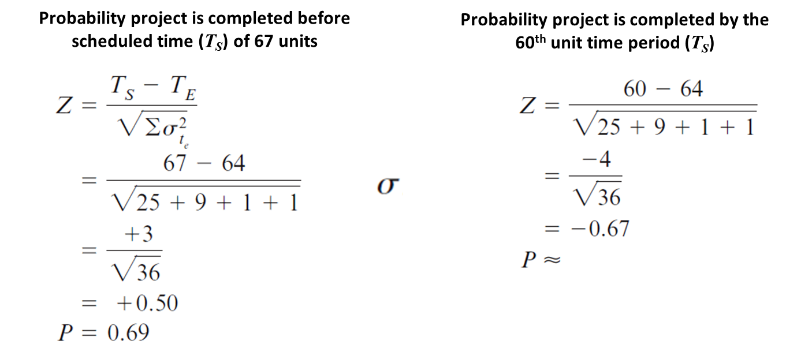
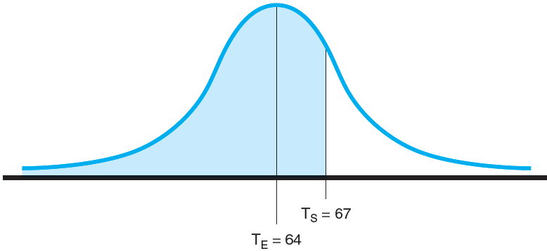
Possible Project Duration
0.2514
FIGURE A7.3

Slide 31
EXERCISE
ACTIVITY | PREDECESSOR | DURATION |  |  | MEAN | VARIANCE
 |  | To | Tm | Tp
A | - | 4 | 4 | 10
B | - | 1 | 2 | 9
C | - | 2 | 5 | 14
D | A | 1 | 4 | 7
E | A | 1 | 2 | 3
F | A | 1 | 5 | 9
G | B,C | 1 | 2 | 9
H | C | 4 | 4 | 4
I | D | 2 | 2 | 8
J | E,G | 6 | 7 | 8
a)Construct the project network
b) Find the expected duration and variance of each activity
c)Find the critical path and expected project duration.
d)What is the probability of completing the project on or before 35 weeks

